Slide 1
Hospital Finder
PROJECT
FINAL REVIEW
Batch Number:33 SECTION:7COM 2
Roll Number | Student Name
20201CEI0095 | T.PRASAD
20201CEI0122 | G.HARIKA
20201CEI0105 | PHANINDRA REDDY
20201CEI0085 | K. VENKATA KUMAR
Under the Supervision of,
Ms. : Shilpa C N
Assistant Professor Grade-1
School of Computer Science Engineering
Presidency University

Slide 2
Introduction
Patient satisfaction has been proven to be one of the most valid indicators of the quality of care. Analysis of patient satisfaction data is in demand by many health-care providers.
Most health-care providers, from doctor’s offices to clinics and hospitals, collect patient satisfaction surveys to evaluate their various services and patient experience.
For improving patient satisfaction, issues of health care provided at the hospital level and the factors that originate those issues from patients’ point of view should be discovered.
Therefore, survey data should be either manually analysed by examining each possible pattern in the data set using conventional methods or an unsupervised methodology is needed to do the analysis with least amount of human interaction.

Slide 3
Doctors can access the system to view their appointment schedules and update appointment statuses in realtime, ensuring effective patient management. Users, on the other hand, can register and log in, enabling them to find nearby hospitals and view available blood donors within their vicinity, promoting timely healthcare access. This healthcare management system aims to bridge the gap between healthcare providers and patients, enhancing the overall healthcare experience and accessibility for all involved parties. In addition to its core features, the multi-
tiered healthcare management system leverages the power of mobile technology through a dedicated Android application.

Slide 4
This mobile application extends the reach of the system, allowing administrators, hospitals, doctors, and users to access critical information and perform essential tasks on the go. The mobile platform enhances flexibility and responsiveness in healthcare management by enabling stakeholders to stay connected, make informed decisions, and respond promptly to evolving situations.
Moreover, the system prioritizes security and data privacy, ensuring that sensitive healthcare information remains confidential and protected across both the web and mobile platforms. This comprehensive approach aims to establish a secure, user-friendly, and interconnected healthcare ecosystem that caters to the diverse needs of administrators, hospitals, doctors, and users alike.
KEYWORDS: Mobile application, Android.

Slide 5
Problem Statement
Healthcare management is a complex and critical area, often plagued by inefficiencies, inadequate accessibility, and disjointed information. Patients struggle to find suitable hospitals and blood donors, while hospitals and doctors encounter challenges in managing appointments and resources. This project addresses the existing problems in healthcare management by providing a comprehensive solution.
The project offers an integrated appointment management system, streamlining the scheduling process for both patients and healthcare providers.Patients can easily book and manage appointments online, reducing wait times and improving the overall patient experience.Healthcare providers benefit from optimized scheduling, reducing noshows and maximizing the efficient use of resources.The project includes a geospatial hospital and blood bank locator, empowering patients to easily find nearby healthcare facilities and blood donation centers. Users can access real-time information on hospital services, specialties, and available blood types, promoting timely and informed healthcare decisions.

Slide 6
Existing Method:The information about the hospitals to the user based on public comments. This is achieved through natural language processing approach using sentiment analysis involving three factors namely, polarity, subjectivity and intensity. Polarity is used to determine the category (positive, negative, neutral) of emotion in a given word. Subjectivity refers to the personal feelings, views or beliefs.

Slide 7
Literature Review
The literature surrounding mobile health (mHealth) applications emphasizes the pivotal role they play in transforming healthcare management. Numerous studies delve into the user-centric design principles that contribute to the success of healthcare apps, exploring factors such as user engagement, satisfaction, and overall usability. Security and authentication methods within healthcare applications have been a substantial focus, with research investigating the impact of secure login methods, such as email verification and password authentication, on data integrity and user trust.
Furthermore, the integration of geolocation services in healthcare apps has been a subject of interest, as it significantly enhances accessibility and user experience by providing location-based services. Studies on the efficiency and effectiveness of appointment scheduling features within healthcare applications highlight their impact on patient outcomes and healthcare provider workflows. The integration of electronic health records (EHR) .

Slide 8
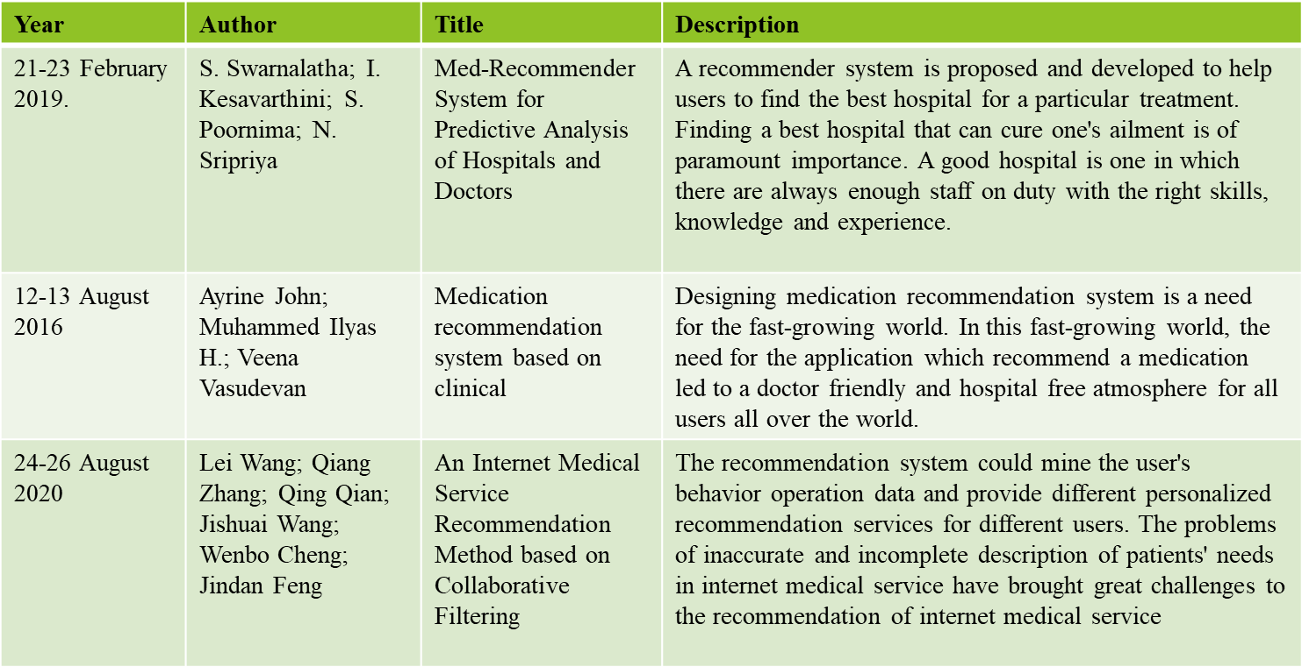
Literature Review

Slide 9
Research Gaps Identified
Registration and Login:
Users can register on the app, providing essential details for a personalized experience.
Secure login methods, such as email verification or password authentication, ensure data integrity.
Hospital Search:
Users can search for nearby hospitals based on location, specialty, or other relevant criteria. - The app utilizes
Appintment Booking:
Users can view available appointment slots for doctors at their chosen hospital.
Booking functionality allows users to schedule appointments conveniently.

Slide 10
Blood Donor Database:
Users can access information on nearby blood donors, fostering timely access to critical healthcare resources.
Donors may register through the app, providing their availability and blood type.
2.Doctor Interaction:
Doctors can create and manage their profiles on the app, including their specialties, qualifications, and availability.
Appointment Management:
Doctors can view their appointment schedules.
3.Hospital Interaction:
They will get the appointment for the user.
Hospitals integrate their information into the system, including details

Slide 11
Proposed Methodology
The proposed healthcare management system envisions a comprehensive, integrated platform that revolutionizes the healthcare landscape.
It offers secure access for administrators to manage hospitals and blood donors, while hospitals can efficiently handle doctor appointments.
Doctors can seamlessly manage appointments and update statuses, ensuring real-time information. Users will benefit from a user-friendly interface that allows registration, easy login, and access to information on nearby hospitals and available blood donors within a 150-mile radius.

Slide 12
Admin: Administrators, through a secure login, gain the power to manage healthcare facilities efficiently. They can effortlessly add new hospitals to the system, view and update hospital information, and maintain a database of blood donors, ensuring a comprehensive healthcare network. Upon completing their tasks, administrators can securely log out.
Hospital: Hospitals access the system through their unique login credentials. They can seamlessly add doctors to their staff, monitor and view patient appointments, and log out after ensuring effective hospital management.
Doctor: Doctors log in to view their appointment schedules and provide real-time status updates, simplifying patient management. After performing their duties, doctors securely log out.
User: Users, registering and logging in, enjoy easy access to nearby hospitals and available

Slide 13
Specify that the system incorporates automated appointment reminders and notifications for both doctors and users. This feature can help reduce missed appointments, enhance communication, and improve overall scheduling efficiency.Highlight the inclusion of a feedback and rating system for users to provide reviews about their healthcare experiences. This not only serves as a valuable tool for quality improvement but also helps users make informed decisions about choosing healthcare providers. If applicable, mention that the system includes a feature to assist users in locating nearby emergency services. This can be crucial in emergency situations, providing users with quick access to critical healthcare facilities.

Slide 14
Emphasize if the system supports telemedicine services, allowing doctors to conduct virtual consultations. This can be particularly beneficial for users who may not be able to visit a hospital physically. Specify whether the system is accessible through multiple platforms, such as web browsers, mobile applications, and tablets. This ensures flexibility and convenience for users and healthcare providers who may prefer different devices.
Discuss the use of data analytics tools for administrators to analyze healthcare trends, manage resource allocation efficiently, and make informed decisions for the overall improvement of healthcare services.Mention that the system includes training modules and ongoing support services for administrators, hospital staff, doctors, and users to ensure effective utilization and a smooth user experience.

Slide 15
Objectives
User Interaction:
Registration and Login:
Users can register on the app, providing essential details for a personalized experience.
Secure login methods, such as email verification or password authentication, ensure data integrity.
Hospital Search:
Users can search for nearby hospitals based on location, specialty, or other relevant criteria. - The app utilizes
Appointment Booking:
Users can view available appointment slots for doctors at their chosen hospital.
Booking functionality allows users to schedule appointments conveniently.
Blood Donor Database:
Users can access information on nearby blood donors, fostering timely access to critical healthcare resources.
Donors may register through the app, providing their availability and blood type.

Slide 16
Doctor Interaction:
Doctors can create and manage their profiles on the app, including their
specialties, qualifications, and
availability.
Appointment Management:
Doctors can view their appointment schedules.
Hospital Interaction:
-System Integration:
Hospitals integrate their information into the system, including details

Slide 17
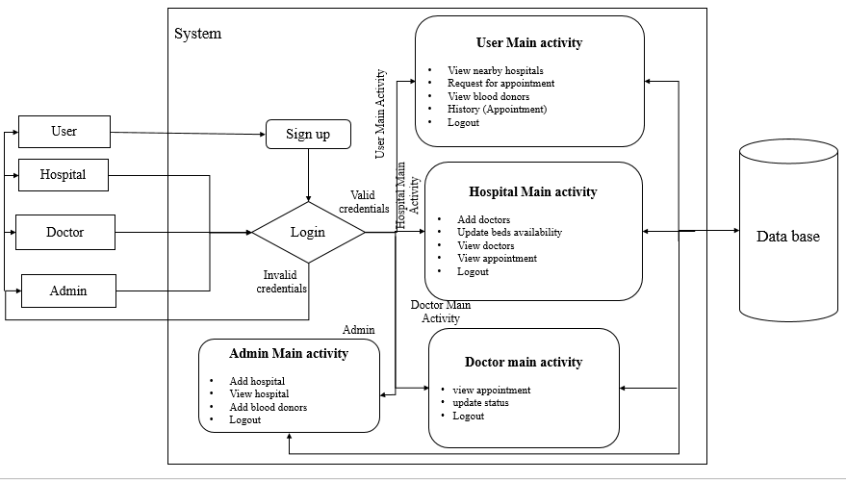
System Design & Implementation

Slide 18
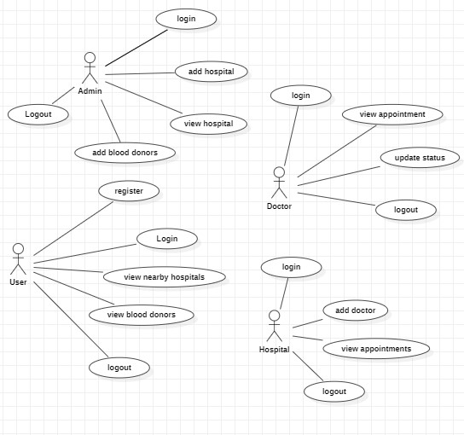
Usecase Diagram

Slide 19
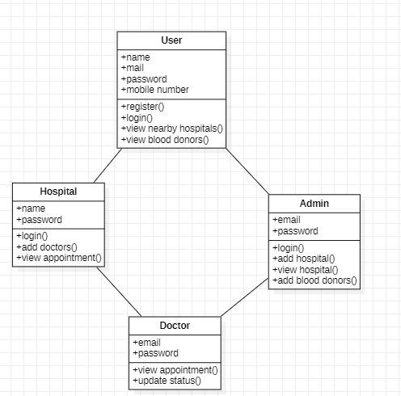
Class Diagram

Slide 20
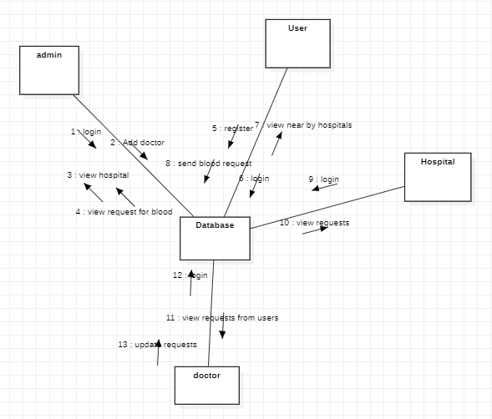
UML diagrams Collaboration

Slide 21
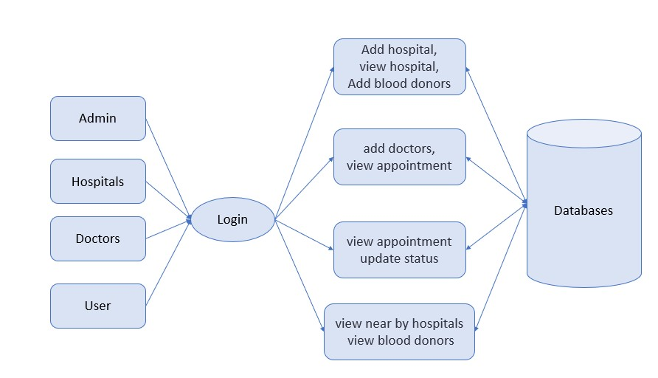
Block Diagram

Slide 22
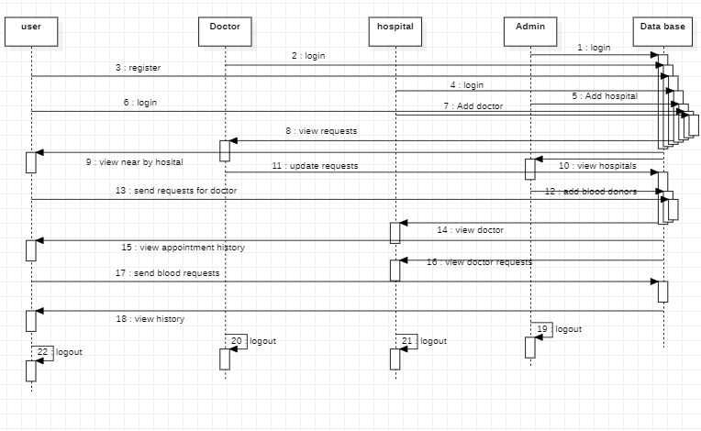
UML Sequence diagrams

Slide 23
Timeline of Project
Review-1:(10-Nov-2023)
-Title ,Abstract ,Literature Survey ,Existing Methods ,
proposed method
Review-2:(30-Nov-2023)
- Source Code Details.
Review-3:(30-Dec-2023)
-Source Code Details and Live Demonstration

Slide 24
10-10-2023
30-10-2023
19-11-2023
09-12-2023
29-12-2023
18-01-2024
(
Review 0)Title finalization
(
Review 1)Abstract ,Literature Survey ,Existing Methods ,
proposed method
(
Review 2)Source Code Details,50%Project.
(
Review 3)Source Code Details and Live Demonstration

Slide 25
Outcomes / Results Obtained
Ease of Hospital Location.
-Users can effortlessly find hospitals, clinics, and medical facilities.
Informed Decision-Making.
-Users can make informed decisions about their healthcare.
Emergency Response Support.
-The app provides quick and accurate directions to the nearest emergency.
Streamlined Appointment Booking.
-Users can efficiently book appointments with healthcare providers through the app

Slide 26
Expected outcomes for this project include a user-friendly healthcare management system that streamlines administrative tasks, enhances appointment management, and improves accessibility for patients. This system will reduce operational inefficiencies, minimize delays, and promote transparent healthcare services, ultimately leading to an improved and efficient healthcare experience for all stakeholders.
Ease of Hospital Location.
-Users can effortlessly find hospitals, clinics, and medical facilities.
Informed Decision-Making.
-Users can make informed decisions about their healthcare.
Streamlined Appointment Booking.
-Users can efficiently book appointments with healthcare providers through the app.

Slide 27
Blood Donor Database:
Users can access information on nearby blood donors, fostering timely access to critical healthcare resources.
Donors may register through the app, providing their availability and blood type.
Appointment Booking:
Users can view available appointment slots for doctors at their chosen hospital.
Booking functionality allows users to schedule appointments conveniently.

Slide 28
Conclusion
In conclusion, the development of the integrated healthcare management system represents a significant leap forward in addressing the existing challenges within the healthcare sector.
This project aims to revolutionize administrative, hospital, doctor, and user interactions, ushering in an era of enhanced efficiency, accessibility, and transparency.
By streamlining processes and providing real-time information, the proposed system will greatly improve the overall healthcare experience.
With this system, we move towards a future where healthcare services are seamless, user-friendly, and readily accessible to all, promoting the well-being of society.

Slide 29
Highlight how the integrated healthcare management system can lead to cost savings for both healthcare providers and patients. Streamlining administrative processes and reducing paperwork can contribute to overall cost-efficiency in the healthcare system. Data Security: Emphasize the importance of data security and privacy in the proposed system. Discuss how robust security measures will be implemented to protect sensitive patient information, ensuring compliance with relevant regulations and building trust among users.
Mention that the integrated healthcare management system is designed to evolve with technological advancements. Continuous updates and integration of emerging technologies (e.g., artificial intelligence, telemedicine) will ensure that the system remains at the forefront of healthcare innovation.User Training and Support:Acknowledge the importance of user training programs and ongoing support to ensure that healthcare professionals and administrative staff can maximize the benefits of the system. This can contribute to a smoother transition and faster adoption.

Slide 30
References
[1] S. Swarnalatha; I. Kesavarthini; S. Poornima; N. Sripriya, "Med-Recommender System for Predictive Analysis of Hospitals and Doctors",2019
[2] Ayrine John; Muhammed Ilyas H.; Veena Vasudevan,"Medication recommendation system based on clinical ",2016
[3] Lei Wang; Qiang Zhang; Qing Qian; Jishuai Wang; Wenbo Cheng; Jindan Feng, "An Internet Medical Service Recommendation",2020
[4] Mohammad Reza Khoie,Tannaz Sattari Tabrizi,Elham Sahebkar Khorasani,"A Hospital Recommendation System Based on Patient ",2017
[5] Qiwei Han,Manas Gaur,"A Hybrid Recommender System for Patient-Doctor Matchmaking in Primary Care",2018

Slide 31
[6] B. Starﬁeld, L. Shi, and J. Macinko, “Contribution of primary care tohealth systems and health,” The Milbank Quarterly, vol. 83, no. 3, pp.457–502, 2005
[7] Sigfried Gold, Noemie Elhadad and James J Cimino, "Extracting Structured Medication Event Information from Discharge Summaries", 2008.
[8] Cathal Doyle, Laura Lennox and Derek Bell, "A systematic review of evidence on the links between patient experience and clinical safety and effectiveness", 2013.
[9] L. Yang, C.-K. Hsieh, H. Yang, J. P. Pollak, N. Dell, S. Belongie, et al., "Yum-Me: A personalized nutrient-based meal recommender system", 2017.
[10] K.W. Tan, H.C. Lau and F.C.Y. Lee, "Improved patient length-of-stay in emergency department through dynamic queue management", 2013.

Slide 32
[11] S. Swarnalatha; I. Kesavarthini; S. Poornima; N. Sripriya, "Med-Recommender System for Predictive Analysis of Hospitals and Doctors",2019
[12] Ayrine John; Muhammed Ilyas H.; Veena Vasudevan,"Medication recommendation system based on clinical ",2016
[13] Lei Wang; Qiang Zhang; Qing Qian; Jishuai Wang; Wenbo Cheng; Jindan Feng, "An Internet Medical Service Recommendation",2020
[14] Mohammad Reza Khoie,Tannaz Sattari Tabrizi,Elham Sahebkar Khorasani,"A Hospital Recommendation System Based on Patient ",2017
[15] Qiwei Han,Manas Gaur,"A Hybrid Recommender System for Patient-Doctor Matchmaking in Primary Care",2018

Slide 33

Thank You

